Slide 1
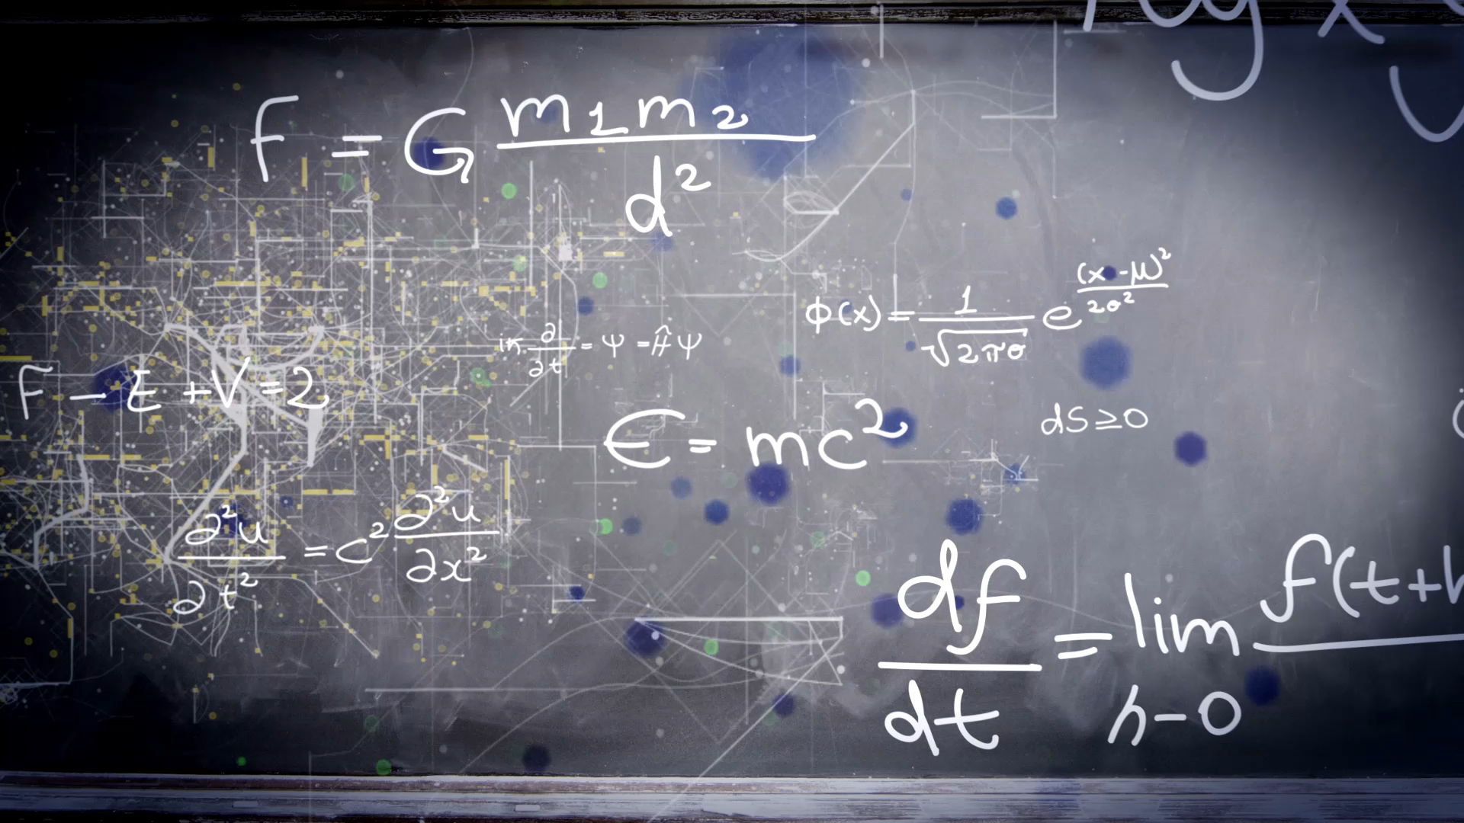
Naïve Bayes Algorithm
Multinomial Naïve Bayes Classifier

Slide 2
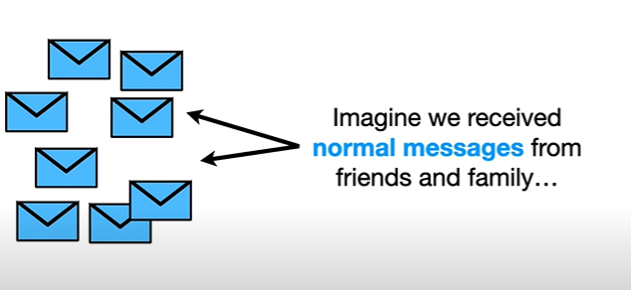

Slide 3
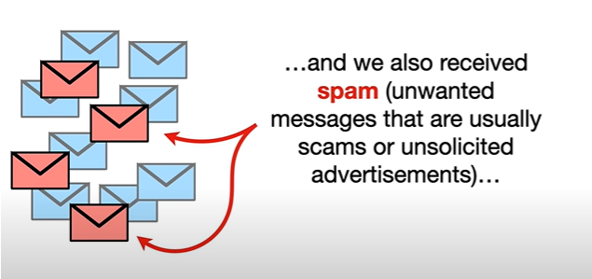

Slide 4
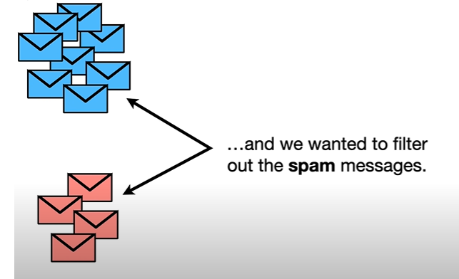

Slide 5
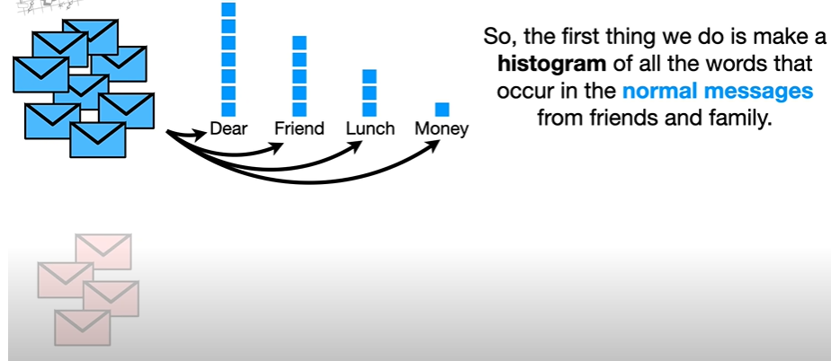
Histogram or word frequency count

Slide 6
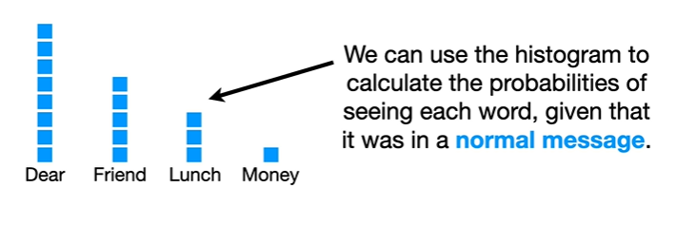

Slide 7
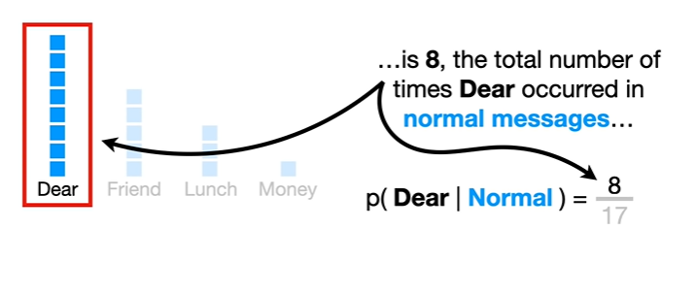

Slide 8
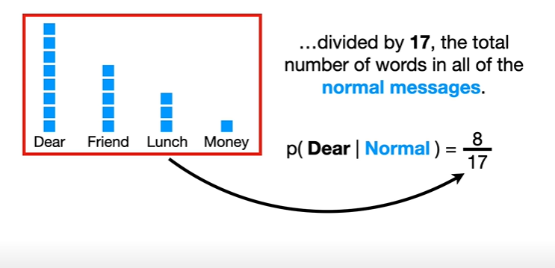

Slide 9
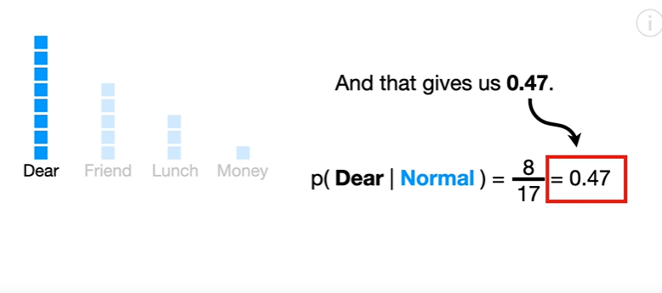

Slide 10
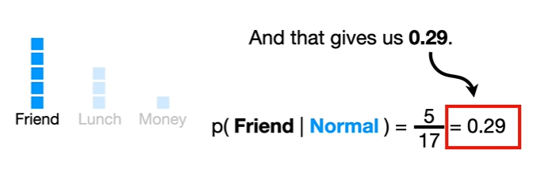

Slide 11
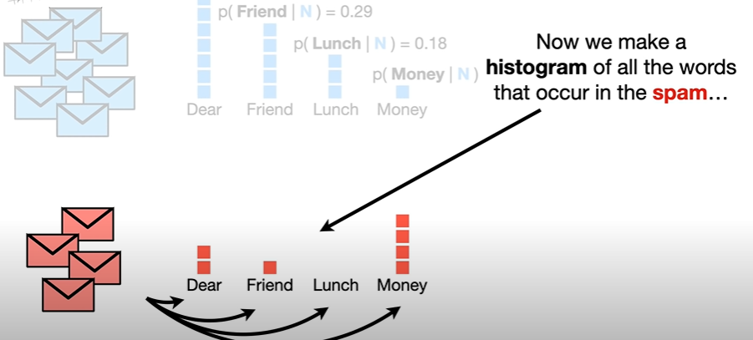

Slide 12
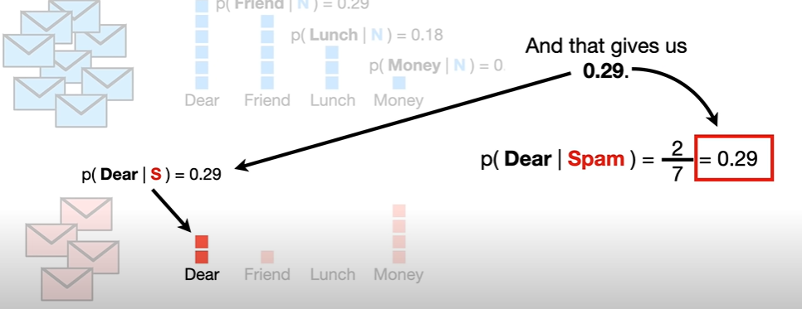

Slide 13
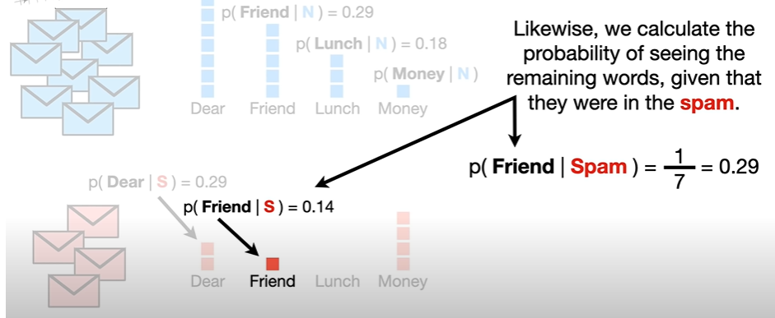

Slide 14
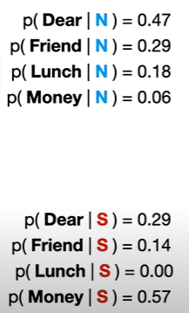
Probabilities are also called “likelihoods”

Slide 15
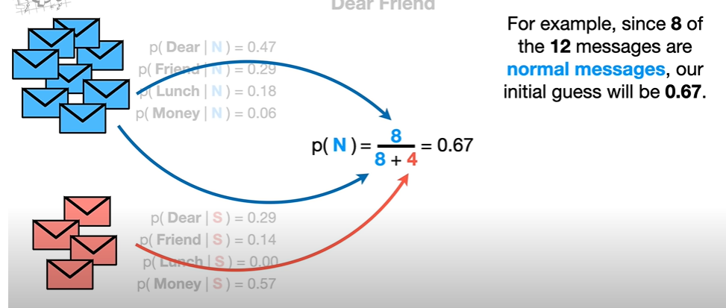
Probability of any message to be normal

Slide 16
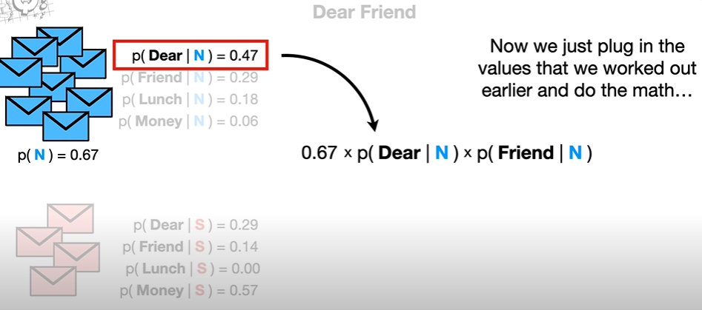
Probability of “Dear Friend” = p(N)*p(Dear|N)*p(Friend|N)

Slide 17
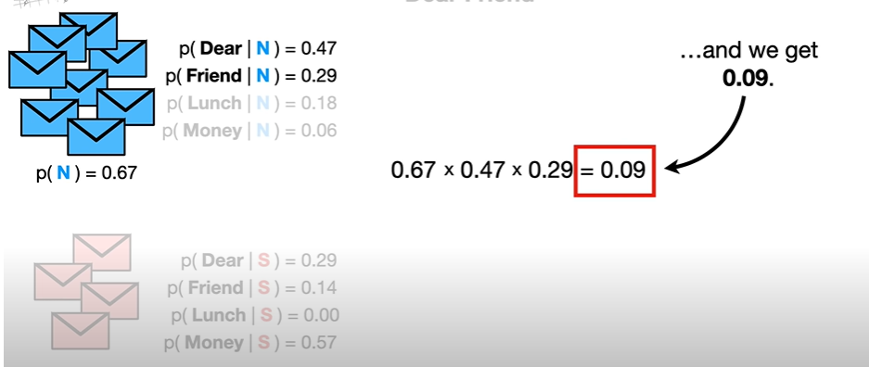
We can think of 0.09 as the score that “Dear Friend” gets if it is a “normal” message
p(N|Dear Friend) * 0.09

Slide 18
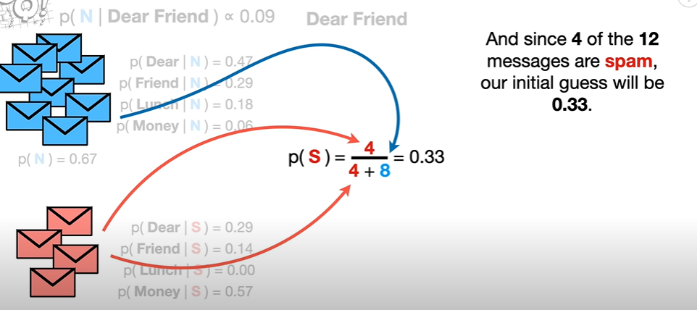
Similarly we calculate the same for spam scenario

Slide 19
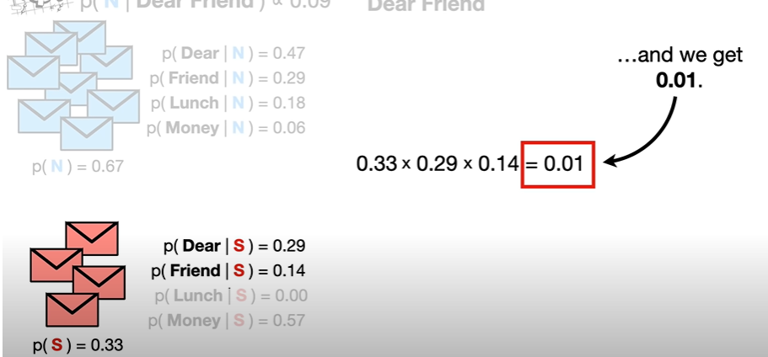
Probability of “Dear Friend” = p(S)*p(Dear|S)*p(Friend|S)
We can think of 0.01 as the score that “Dear Friend” gets if it is a “spam” message

Slide 20
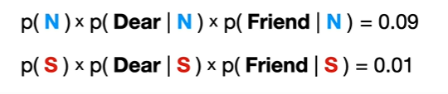
RESULT
Since 0.09 is greater than 0.01
We will treat this as a normal message

Slide 21
Please see the excel calculation for tweets

